Slide 1
USER ADAPTIVE EXAMINATION SOFTWARE
Training Project Presentation
Submitted By :
Aman Kaushik CO10305
Anchit Jatana CO10307

Slide 2
Company Profile
Techno Campus is a respected learning solutions provider which is dedicated to create success stories for their students. They have unique integrated learning solutions which is a proven approach and can be customized to the individual training needs in the area of Technical Training, Desktop Application Training, Professional Development Training.
It is certified from Aptech which was established in 1986 and is a pioneer in IT education which so has trained more than 6.4 million students.
Techno Campus has a niche in providing training to Engineering & MCA Students. Thousands of Engineering students from Chandigarh, Punjab, Haryana, Rajasthan and Himachal have successfully completed their Industrial and Summer Training.
The focus of the Industrial Training is to facilitate students with Live Projects on latest technologies like VB.NET, ASP.NET, ORACLE DBA/DEVELOPER, J2EE, JDO, STRUTS, LINUX, Networking under the strict guidance of Industry Experts.

Slide 3


Based Application Software
Our application software –”User Adaptive Examination Software “is solely based on JAVA .
What is Java?
Java is a programming language.The language derives much of its syntax from C and C++ but has a simpler object model and fewer low-level facilities than either C or C++. Java applications are typically compiled to bytecode (class file) that can run on any Java Virtual Machine (JVM) regardless of computer architecture.
Java is a general-purpose, concurrent, class-based, object-oriented language that is specifically designed to have as few implementation dependencies as possible.
JAVA is completely “Platform Independent” i.e. the JAVA Development
Kit(JDK) is available for various operating system’s and hence the JAVA code can be interpreted on any system.

Slide 4
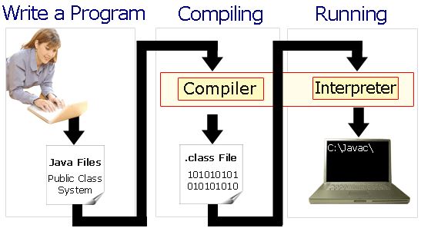
How JAVA Works
Through JAVA VIRTUAL MACHINE(JVM)

Slide 5
Layout of our Project
On the User-End we have JAVA coded interfaces.
At the Back-End we have MY SQL Database.
Linking these two ends is a “Linking Channel” or the drivers called the JDBC(JAVA Database Connectivity) Drivers.
MY SQL Database
JDBC Drivers
JAVA coded
Interfaces

Slide 6
Overview of our Project
What our Project Offers?
Our project is a complete software solution ,catering to all the requirements of various examination systems:
Registration of candidates for the Exam(For Eligible Candidates).
Question database building facility(For the Examiner).
Login and Exam taking facility(For the Registered Candidates).

Slide 7

Contd.
To solve each of the Purpose mentioned above,we have designed a set of 7 Modules(coded in JAVA)
Module #1 & #2 –For Registration process.
Module #3,#4,#5,#6 –For Exam Taking.
Module # 7 –Question Database building.
These modules are linked with the “MY SQL database” at the back-end , which offers a purpose to the operational functionality for each of these.
We will be presenting to you the functionality through a (Wireless Local Area Network – “adhoc” )
With one laptop as Server and the other as a client.
NOTE-This project can also run online.

Slide 8

Features of our Project
Our project i.e. “User adaptive Examination System” is purely a new concept in the examination arena.
It is one of it’s own kind.
Its functionality is not predefined , but based upon the users response during the test.
It has real time decision making ability and real time program flow control features.
It judges the candidates responses and thereafter provides a difficulty level to the candidate.

Slide 9

of our Software.
Our Examination program maintains three difficulty levels :
Easy
Normal/Medium
Difficult
Each level has different marks i.e:
Getting Easy question correct - 3 marks.
Getting Medium question correct - 4 marks.
Getting Difficult question correct - 6 marks.
Though only 1 mark is deducted for each wrong answer.
With every correct answer there is a “STEP UP” in difficulty level.
With every wrong answer there is a “STEP DOWN” in the difficulty level.

Slide 10
Contd.
This Examination pattern/system offers the candidates to get questions correct and step up their difficulty level hence get awarded more for answering higher level questions correct.
This Pattern is of utmost importance when considering International Exams like GMAT, where a candidate is required to set score benchmarks.
(obviously a brilliant student should be given more marks for answering difficult questions correct).

Slide 11
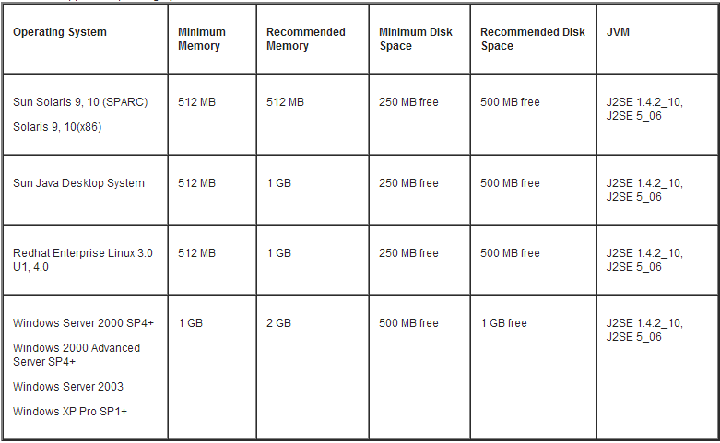
System Requirements
Hardware & Software Requirements:
Processor: Pentium IV/equivalent or Higher.
MY SQL Database (at the Back-End)

Slide 12
Various Interfaces of our project
Registration interface.
Detail checking page (checking and submission
of details entered).
3. Login interface.
4. Rules and regulations of the examination.
5. Test taking interface.
6. Result displaying interface.
7. Question database building interface.
Registration
Phase.
Examination Phase
Question database building phase.

Slide 13
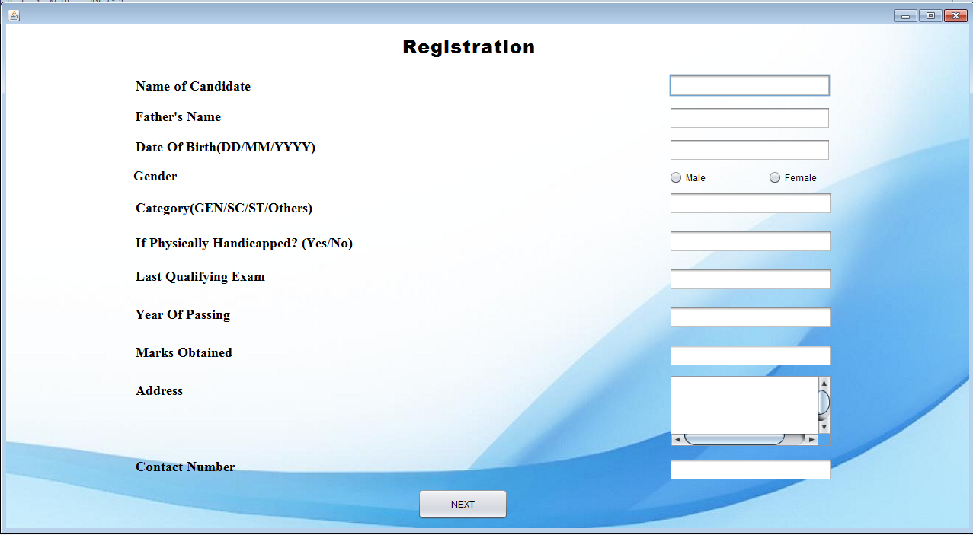
Registration Interface
Takes to the next - detail verification page.

Slide 14
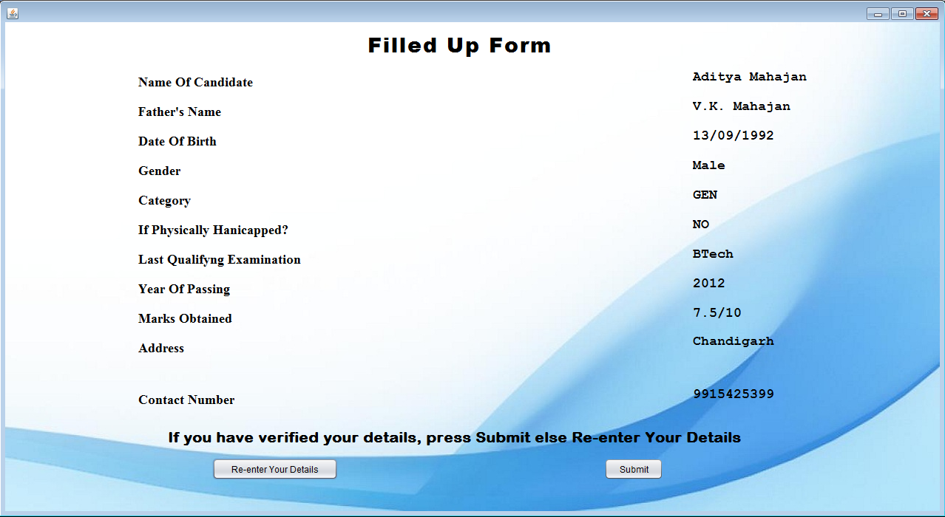
Detail Submission Page
Takes the user to previous page for Re-entering Details.
Submits the details to the database.

Slide 15
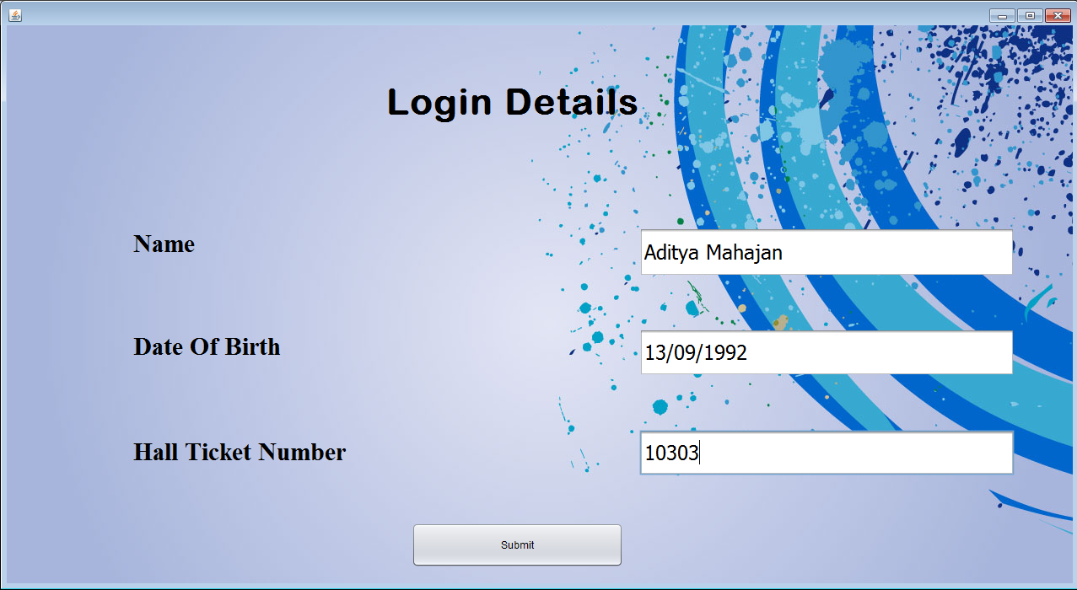
Login Interface
Details filled by the Candidate.
Detail checking from database takes place & the user is taken to the next page of ”Rules and Regulations”

Slide 16
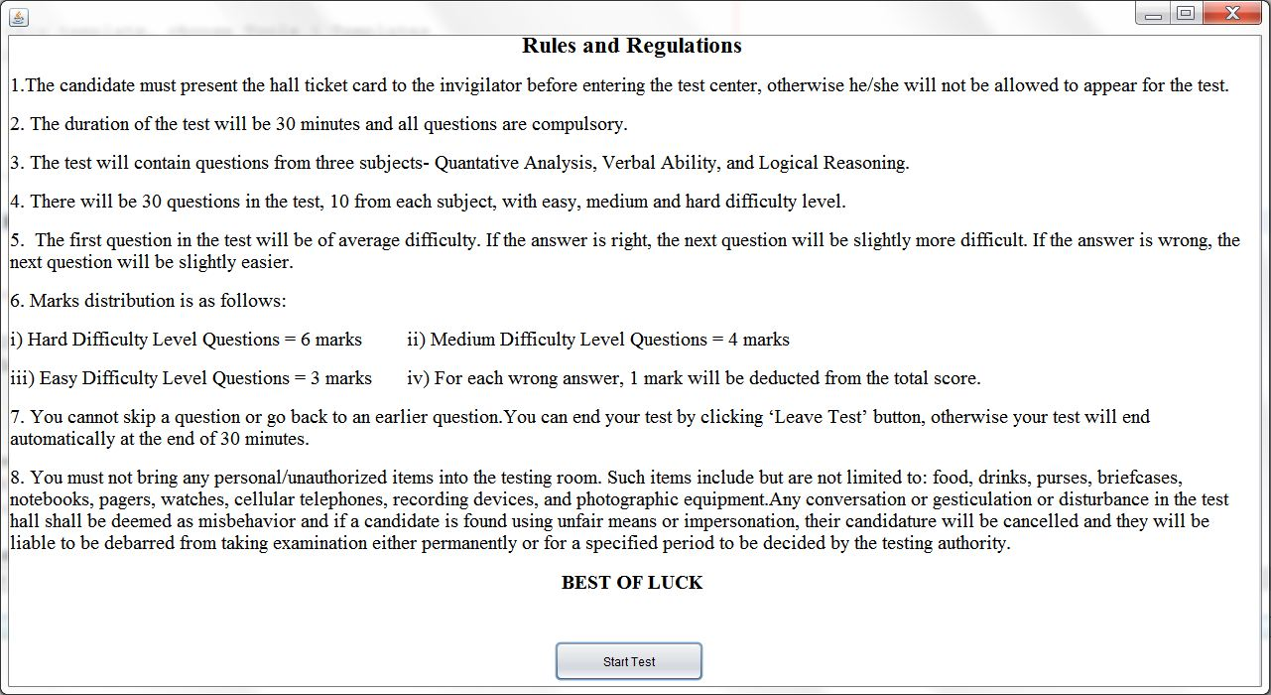
Rules and Regulations Page
As soon as you click HERE , the TEST Begins

Slide 17
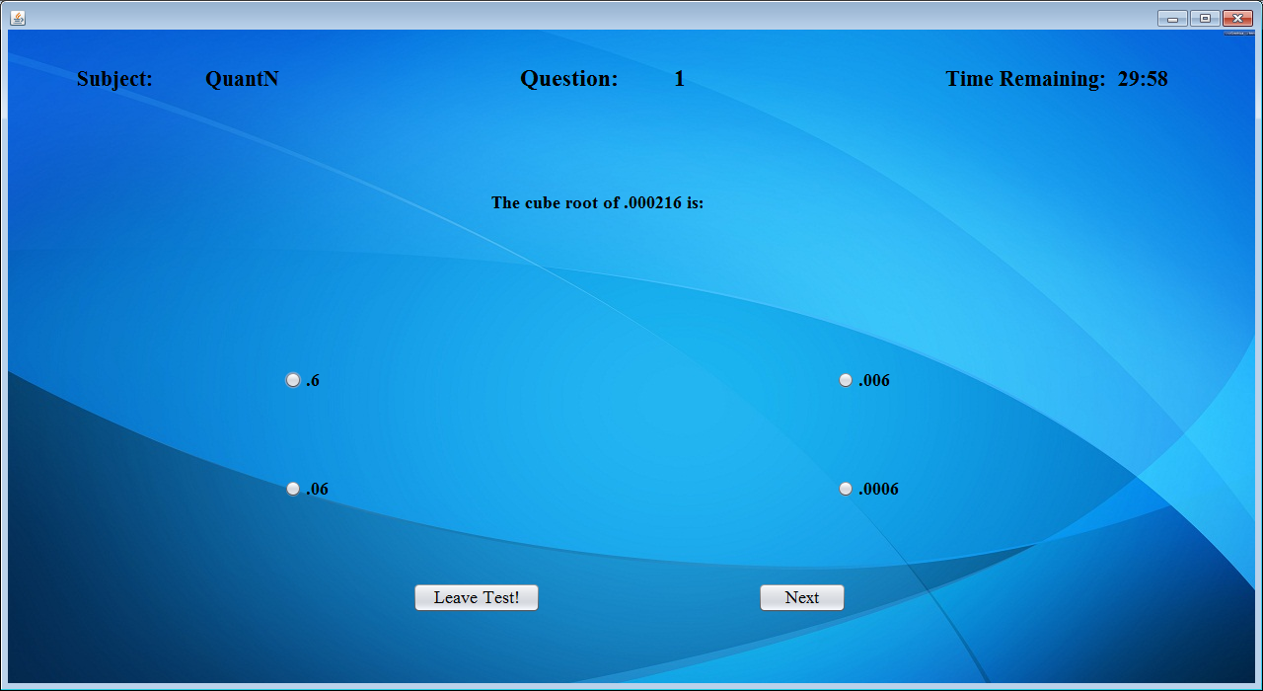
Test interface
The Test starts with Normal/Medium difficulty level.(N=Normal)
The Correct Answer.
If this is chosen:
Difficulty level Stepped up in next question
Else the level is stepped down.

Slide 18
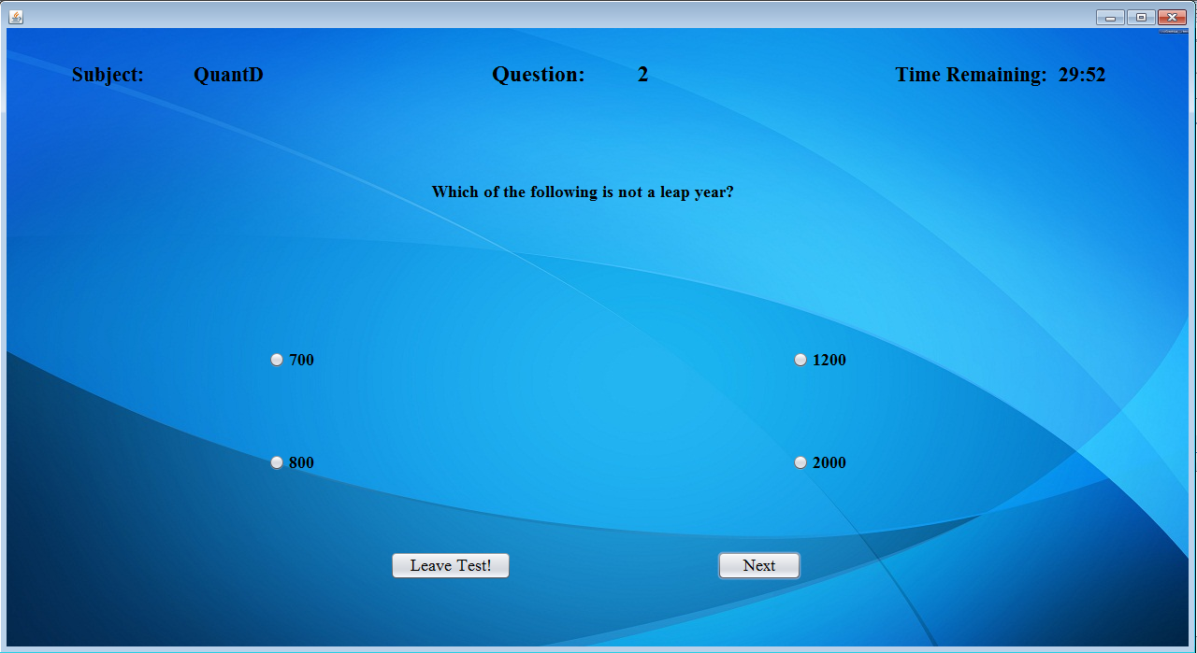
Correct answer Selected(level Stepped up)
Difficulty level stepped up. (Correct answer was selected)
(D=Difficult).
Correct answer.
On selecting this , the difficulty level is maintained , else stepped down.

Slide 19
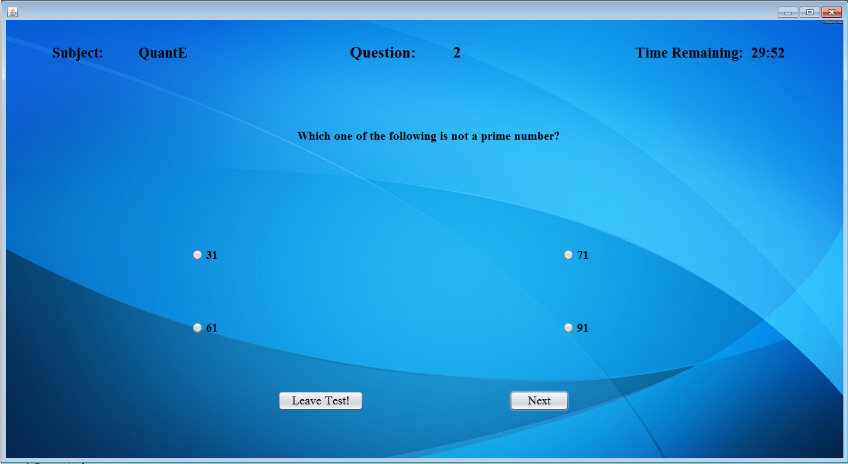
Wrong answer selected(level stepped down)
Difficulty level stepped down. (Wrong answer was
selected)
(E=Easy).

Slide 20
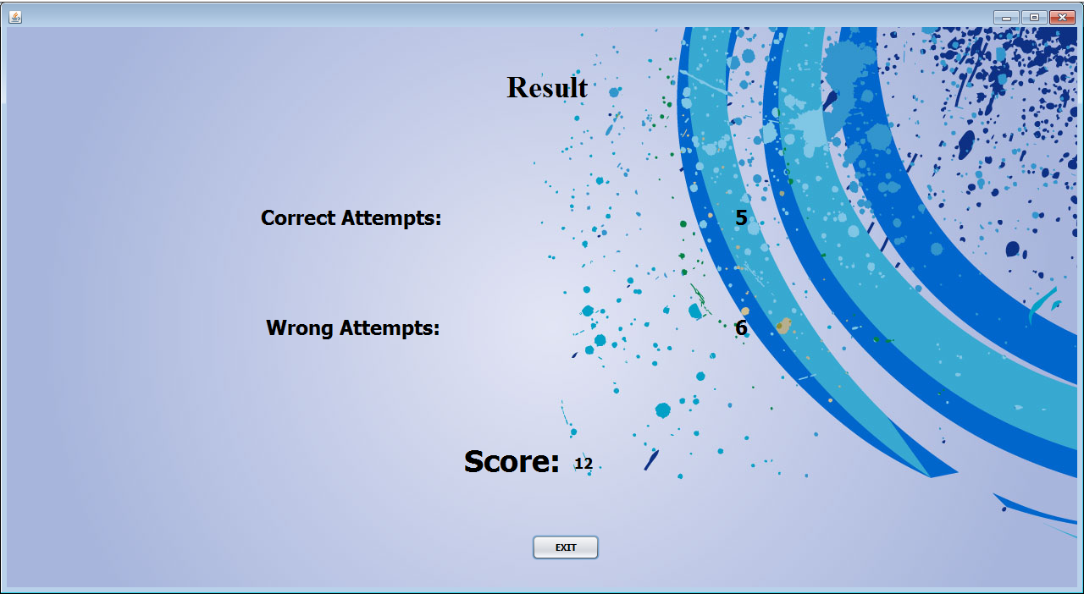
Result Interface
The total score calculated based on the candidate’s response(for various difficulty level questions).

Slide 21
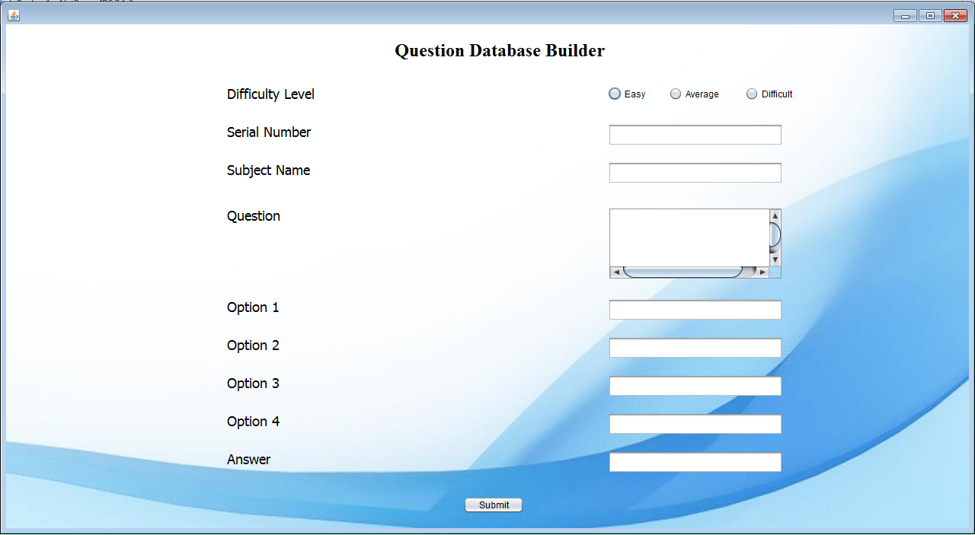
Question Bank Builder
Pressing this button leads to storing of above information in the database.

Slide 22


The Database-Provides meaning to Functionality of these Module.
What is Database?
A database is an organized collection of data. The data is typically organized to model relevant aspects of reality, in a way that supports processes requiring this information.
That is , a database is a collection of information that is organized so that it can easily be accessed, managed, and updated.
Well known DBMSs include Oracle, IBM DB2, Microsoft SQL Server, Microsoft Access, PostgreSQL, MySQL, FoxPro, and SQLite.
We have used Oracle’s MySQL Database at the back-end , which caters to all storage and retrieval requirements.

Slide 23
Role of Database in our Project
Database Is the essence of our “User Adaptive Examination System”
The logic program code (in JAVA) employs “Database Shifting ” which is the very idea behind the “User Adaptability ”of our program.
We have exhibited a test containing three Subjects namely:
Quantitative Analysis.
Verbal Ability.
Logical Reasoning.
(NOTE-These Subjects are randomly chosen from the GMAT examination system just for the demonstration purpose).

Slide 24


How we Implemented
For all the “Registration process” we have created and maintained a database –”regdb”
This database stores the details of the registered candidates.
Helps the program in retrieval of stored records for authentication.
We have designed three discrete database’s for questions:
Database “e” for Easy level questions for all three subjects.
Database “n” for normal/medium level questions of all three subjects.
Database “d” for difficult level questions of all three subjects.
The whole GAME is of database “LINK” shifting , which is solely based on the candidate’s response to the question.

Slide 25

Lets Have a LOOK at the Back-End Database

Slide 26
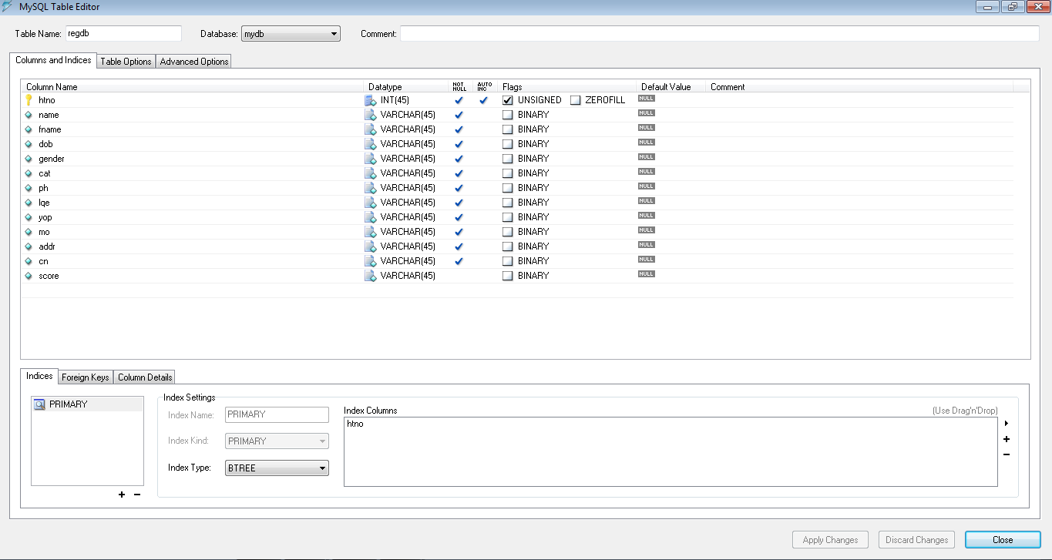
Database – ”regdb”
Automatically generated (Given an Auto-increment facility , with initial value specified)

Slide 27
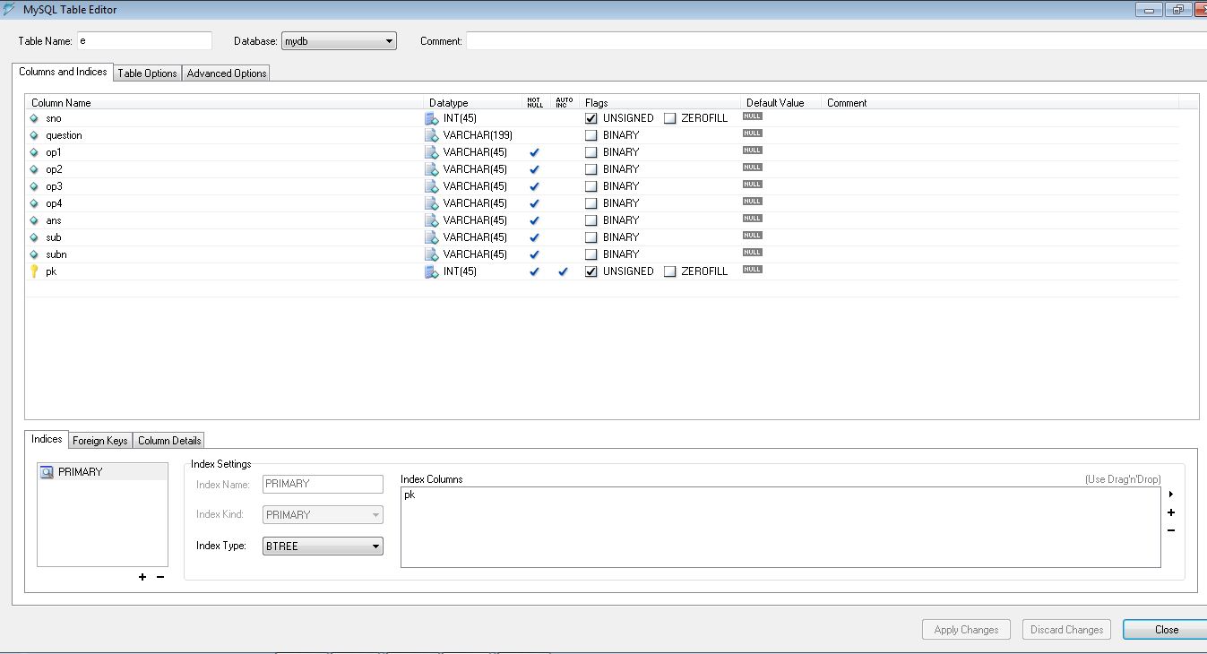
Database – “e” Easy Questions!

Slide 28
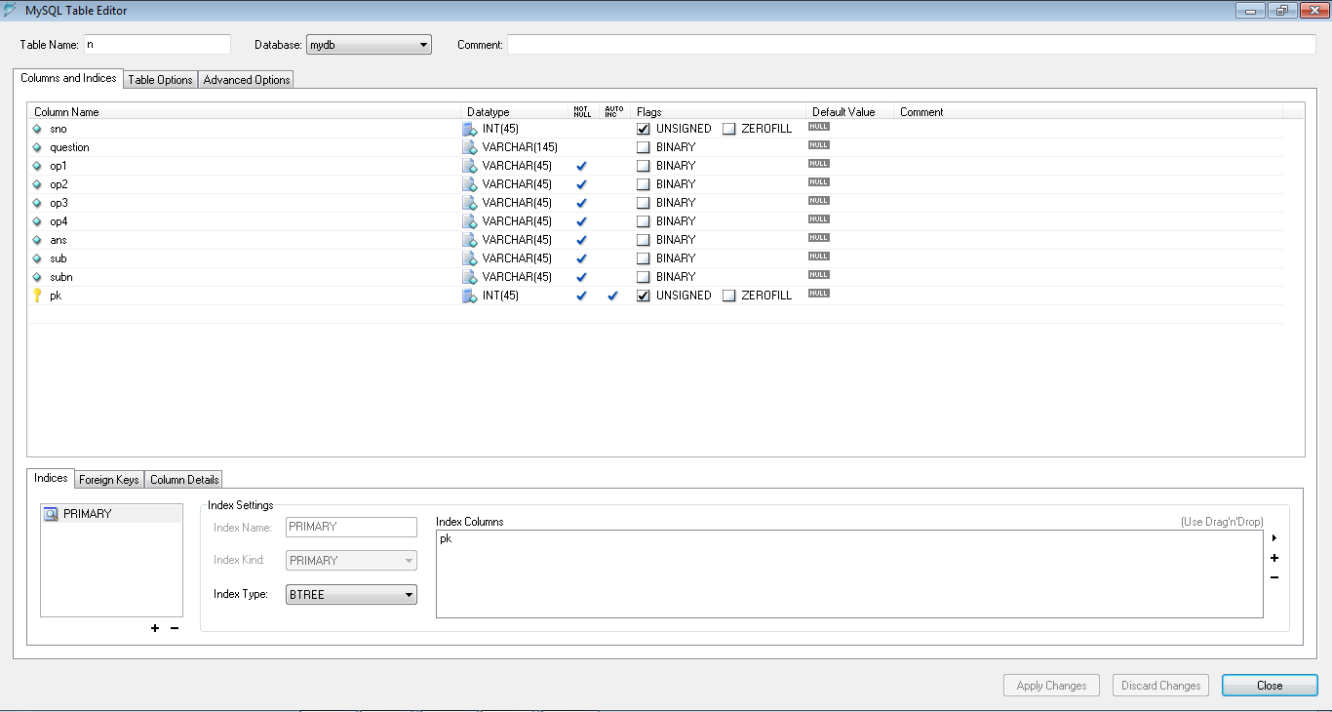
Database – “n” Medium Questions!

Slide 29
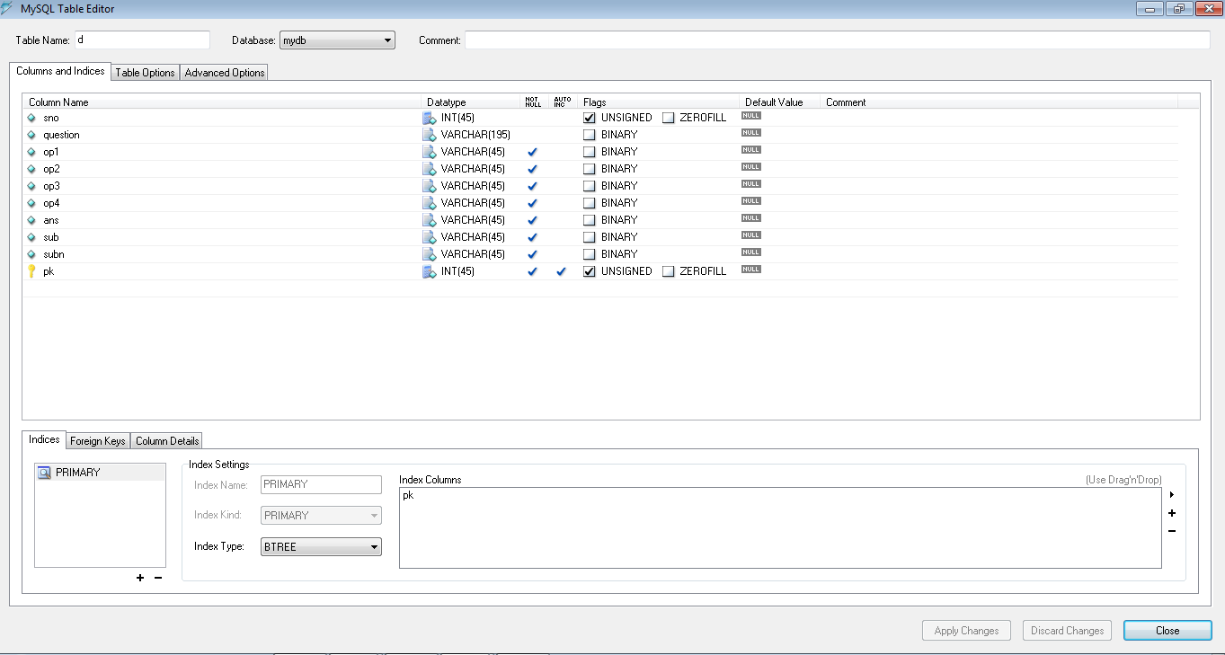
Database – “d” Difficult Questions!

Slide 30

THANK YOU!

